Slide 1
Visualization Ethics, Rhetoric & Critique
JOUR479D/779D
University of Maryland
Nick Diakopoulos

Slide 2
Ethics
“the study and practice of what constitutes the best regulation of human conduct, individually and socially”
– Stephen Ward
Ethics is concerned with articulating apt behavior and conduct: How ought one act according to standards of character?
Making sound editorial decisions in data acquisition, analysis, and presentation.

Slide 3
Ethical Principles in Journalism
Seek truth and report it as fully as possible
Avoid misleading, misinforming, obfuscating, or deceiving; consider potential errors of interpretation
Be transparent
Trace and disclose rationale and methods for arriving at preferred interpretation
Engage community as an end, rather than as a means
Treat data from people with human dignity; consider privacy and anonymity
McBride and Rosenstiel. The New Ethics of Journalism. 2014.
Notes:
Principle 1 is particularly relevant to data stories because of the many possibilities to mislead, misinform, obfuscate, or even deceive using visualization. As will be discussed in the next sections, opportunities for (mis-)guiding the end-user’s interpretation of data can arise during every phase of production from acquisition and how the data is quantified, to how it is normalization, aggregated, filtered, visually encoded, annotated, and made interactive. Principle (2) is relevant to the ways in which data stories and insights from data are found and interpreted as stories. Given that many interpretations may arise from a dataset it becomes important for the storyteller to be able to trace and disclose their rationale and process for arriving at a preferred interpretation, particularly as it relates to data acquisition and transformation steps that may go unseen unless they are given explicit consideration for disclosure. Finally, principle (3) hints at another dimension of importance when telling stories with data: the individual people who the data represents are to be treated with humanity and respect and not be seen only as a means for telling a story. This principles also speaks to the relevance of interactivity in data-driven storytelling and of the ethical consideration given to engage community through data rather than dictate that data to a community.

Slide 4
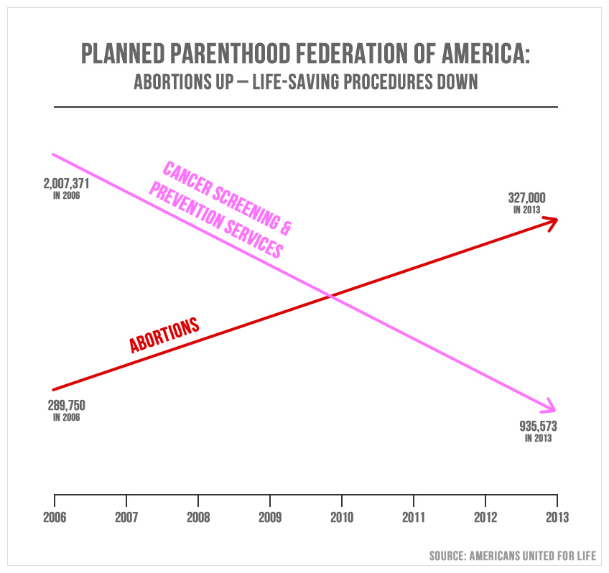
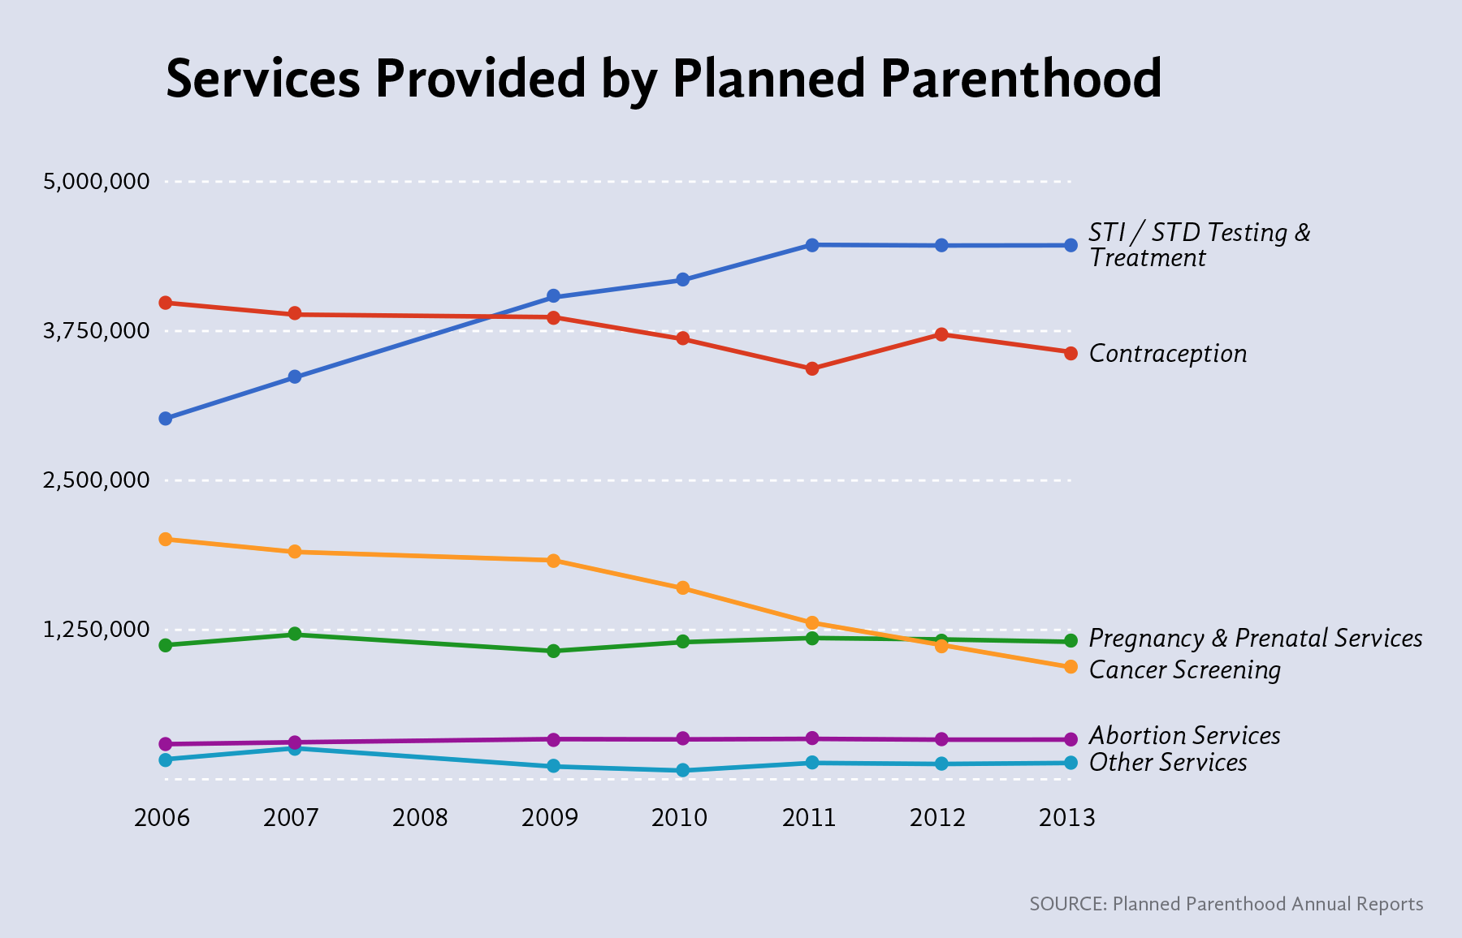
Notes:
Anyone see this graph published last year? By Americans United for Life (AUL). this chart was shown briefly during a House government oversight committee on September 29th, 2015 in which Cecile Richards, president of Planned Parenthood, was questioned by House Republicans.
What’s wrong with this chart? Different y-axes
Also: the American College of Obstetricians and Gynecologists started advising a reduction of frequency in 2009. Previously, women received a pap smear to screen for cervical cancer once a year, but it is now recommended that pap smears should be performed every three years. … so that explains the decline in cancer screenings.

Slide 5
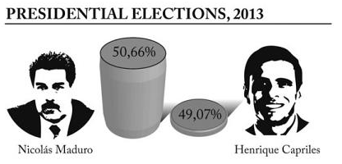
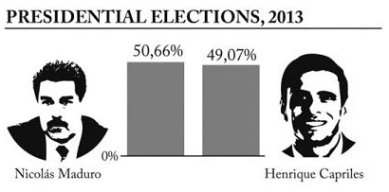
Graphical Integrity: Baselines
Source: Cairo. Graphics Lies, Misleading Visuals..
Notes:
Let’s start with some examples of misleading graphics and why they’re misleading.
The hope is that if you understand how graphics mislead then you can be more faithful in the way you create graphics by not making these mistakes.
Deceptive baseline. Because the top chart doesn’t start at 0% it distorts the height of the bars.

Slide 6
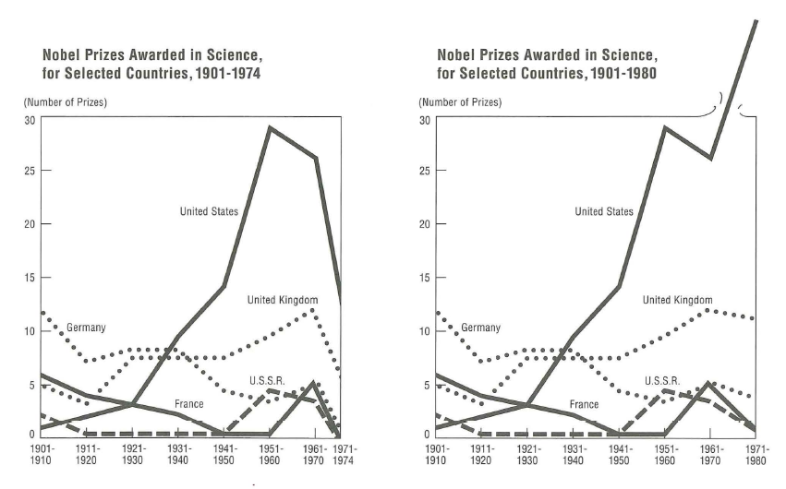
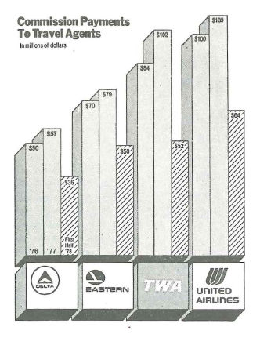
Graphical Integrity: Aggregates
Notes:
By showing a partial year, this bar chart portrays a false comparison or trend of things going down.
Aggregates can mislead.

Slide 7
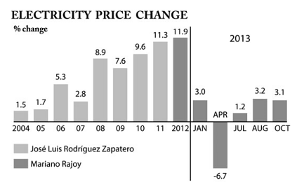
Graphical Integrity: Aggregates
Source: Cairo. Graphics Lies, Misleading Visuals..
Notes:
The units change from years to months and mislead you because you’re again comparing apples and oranges

Slide 8
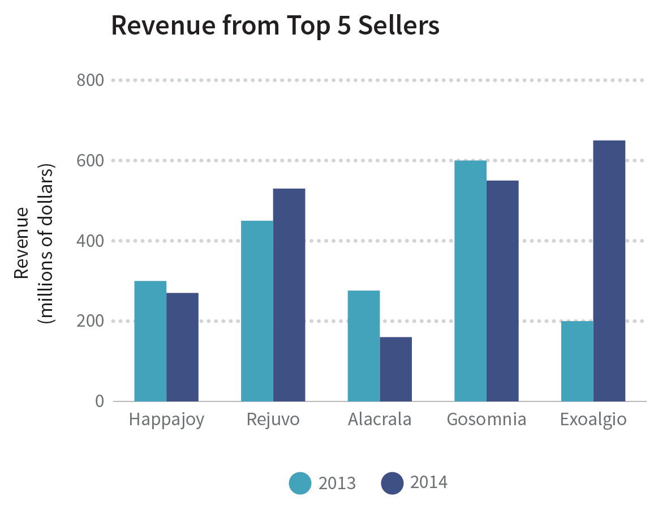
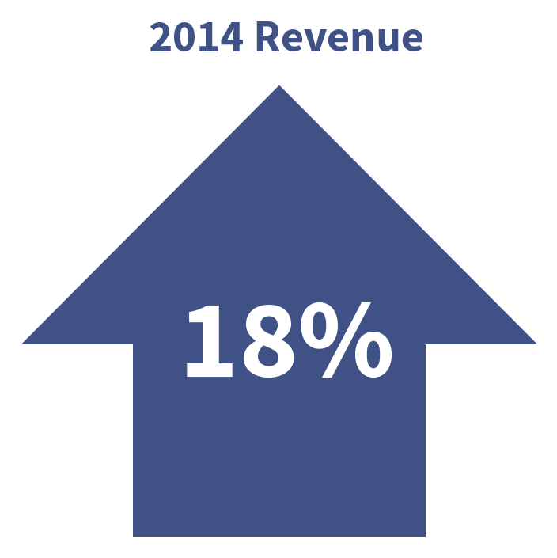
Graphical Integrity: Aggregates
Source: Data + Design. Chapter 18: Common Visualization Mistakes.
Notes:
By showing a partial year, this bar chart portrays a false comparison or trend of things going down.
Aggregates can be used to obfuscate, 18% increase, but in fact 3 of the sales figures decreased and 1 was a huge success. So the data can show a lot more nuance.

Slide 9
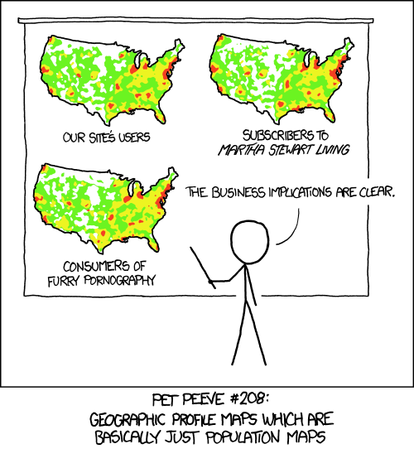
https://xkcd.com/1138/
Notes:
XKCD comic creator Randall Munroe illustrates the core problem with non-population normalized mapping in the next figure. The basic issue is that, for many types of data, plotting them on a choropleth map will simply show hot spots in areas of high population. The map ends up showing high population density around urban areas rather than the variable of interest. The correction here is to divide by the population in the area (e.g. state) that is being mapped, thus transforming the variable mapped to a population-normalized version.

Slide 10
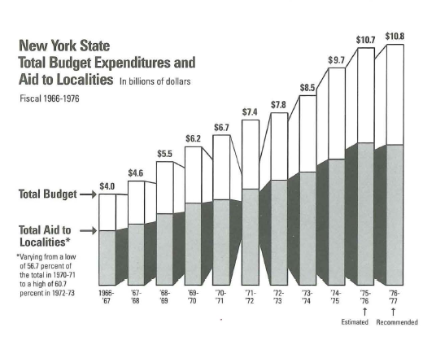
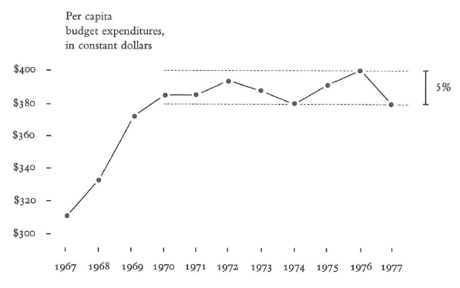
Graphical Integrity: Normalization
Notes:
It’s important to properly normalize your data so as to account for variations that are not germane to your story. But what IS your story? If your story is about absolute budget increase then the 1st graph may be ok.
But maybe the story also needs to take into account population increases in that time span in order to offer a faithful view of the issue. What’s the right answer?
In general though you should consider deflated and normalizes units for displays of money.

Slide 11
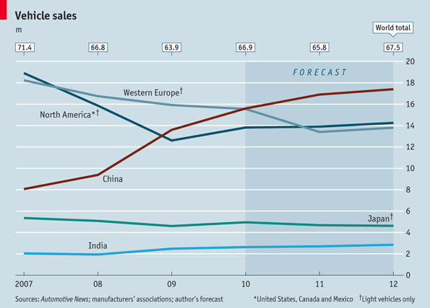
Graphical Integrity: Definitions
Notes:
The story the graph tells is pretty clear: Sales in China are rocketing up while they’re declining or stagnant in North America and Europe. But look more closely. The data for Western Europe and North America is defined as an aggregation of light vehicle sales, according to the note in the lower-right corner. How would the story change if the North American data included truck, SUV, and minivan sales? The story you get from these kinds of data graphics can depend entirely on what’s aggregated (or not aggregated) together in the measure. Aggregations can serve as a tool of obfuscation, whether intentional or not

Slide 12
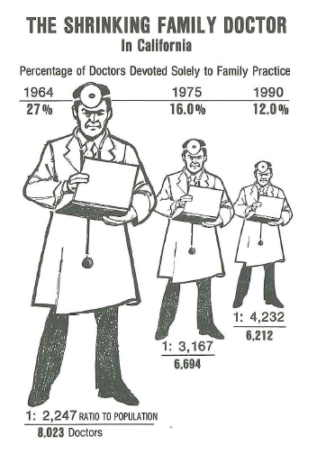
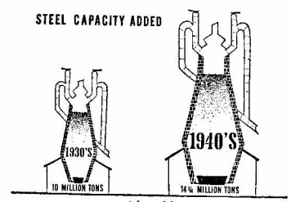
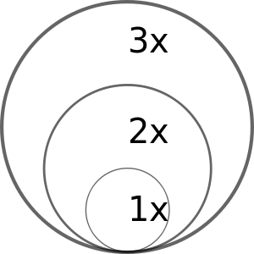
Graphical Integrity: Encoding
Notes:
If we map a data value to radius or diameter, the physical size of the circle goes up as a square. Instead consider scaling by the area of the symbol (a circle in this case).
The encoding of data into symbols in this vis of doctors devoted to family practice suffers the same issue: showing a 1 dimensions attribute as an area of the symbol leads to distortion.

Slide 13
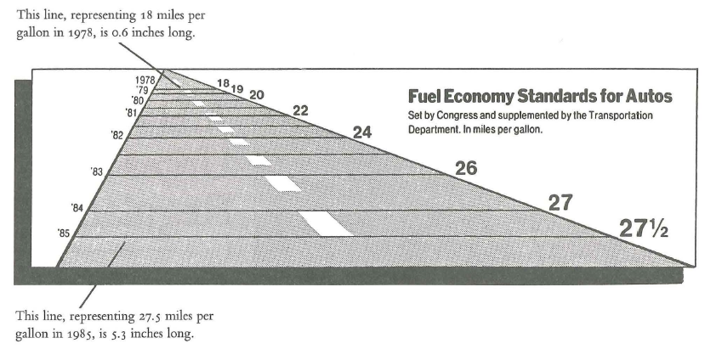
Graphical Integrity: Perspective
Notes:
Not only are years not uniformly spaced, but you have font sizes changing.
You can’t differentiate the difference in a change of value and in the perspective distortion

Slide 14
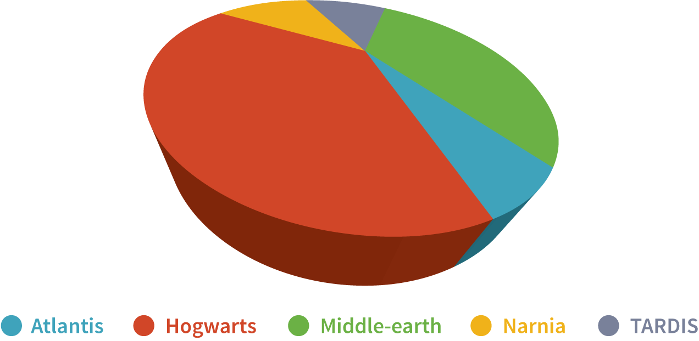
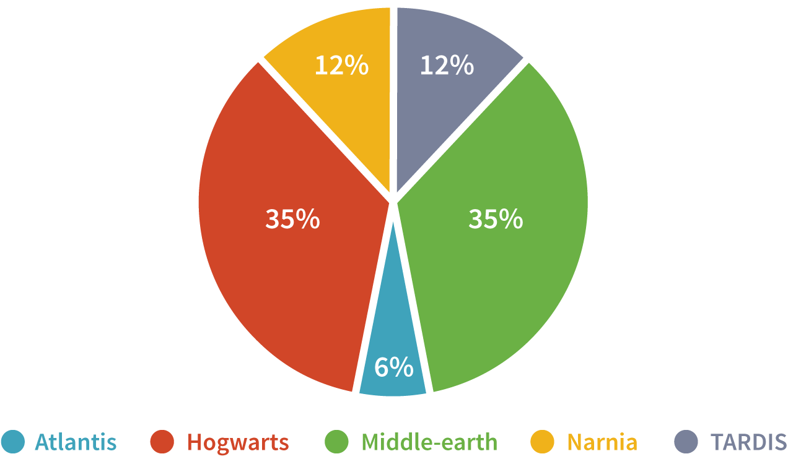
Graphical Integrity: Perspective
Source: Data + Design. Chapter 17: Perception Deception.

Slide 15
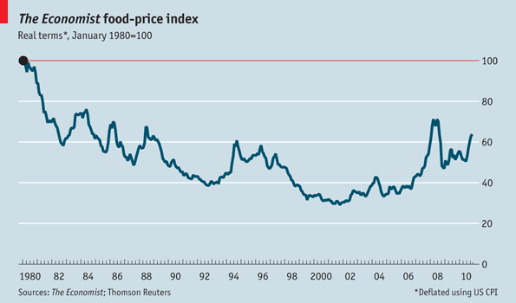
Graphical Integrity: Filtering
Time of baseline matters: “If the chart had began in, say, 1976 it would look significantly different because January 1980 was when the worst of Carter-era inflation was visible.”
Don’t “quote” data out of context – consider its cropping

Slide 16

Truncated y-axis
Notes:
The next figure is an example of a truncated y-axis that is misleading. In moving from a value of 75% in 2008-2009 to 78% in 2009-2010 the height of the bar (represented as a stack of books) is doubled, visually exaggerating the actual increase. Another misleading aspect of this chart is that the height of the bar from 78% to 79% goes up quite a bit but doesn’t change at all for the exact same increase from 81% to 82%. In both cases the height of the bar should go up the same amount.

Slide 17
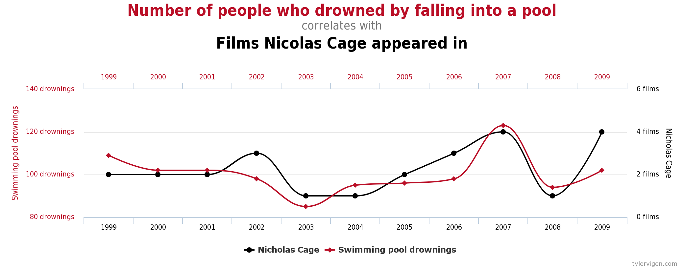
Implied Relationships
http://www.tylervigen.com/spurious-correlations

Slide 18
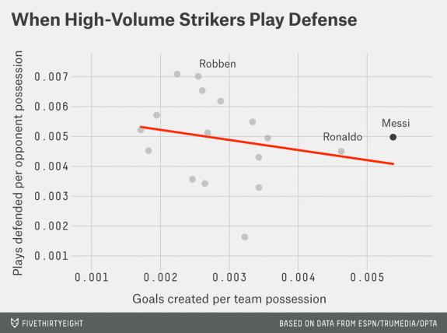
Implied Relationships
http://fivethirtyeight.com/features/lionel-messi-is-impossible/

Slide 19
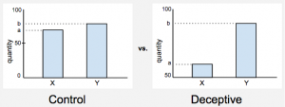
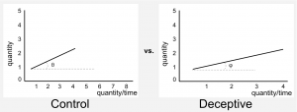
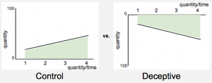
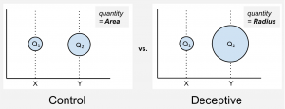
Vis Deception
Truncated axis
Aspect Ratio
Inverted axis
Area Mapping
How Deceptive are Deceptive Visualizations?: An Empirical Analysis of Common Distortion Techniques. Proc. CHI 2015.
Notes:
A recent experiment looked at the extent to which 4 different manipulation strategies were effective in changing people’s perceptions.
We present half of the participants with a deceptive version of the chart and half with the not deceptive one. Then, we ask the same question to both and measure the difference between the two. Let me give you an example.
We show bar charts similar to those shown above and say that they represent the percentage of population with access to drinking water in Willowtown and Silvatown (yes we use fake names, see why in the paper). One version has a truncated axis, the other does not. Then we ask: “How much better are the drinking water conditions in Willowtown as compared to Silvatown?“.
The participants do not have to provide a precise number, rather they have to provide a gross estimation of the effect using a 5-item Likert scale, ranging from “slightly better” to “substantially better“.

Slide 20
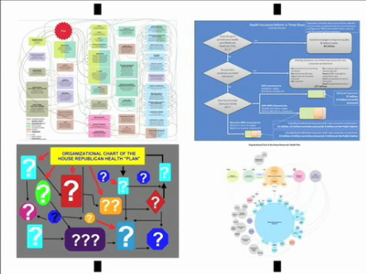
Vis Rhetoric – Chart Wars
https://www.youtube.com/watch?v=tZl-1OHw9MM

Slide 21
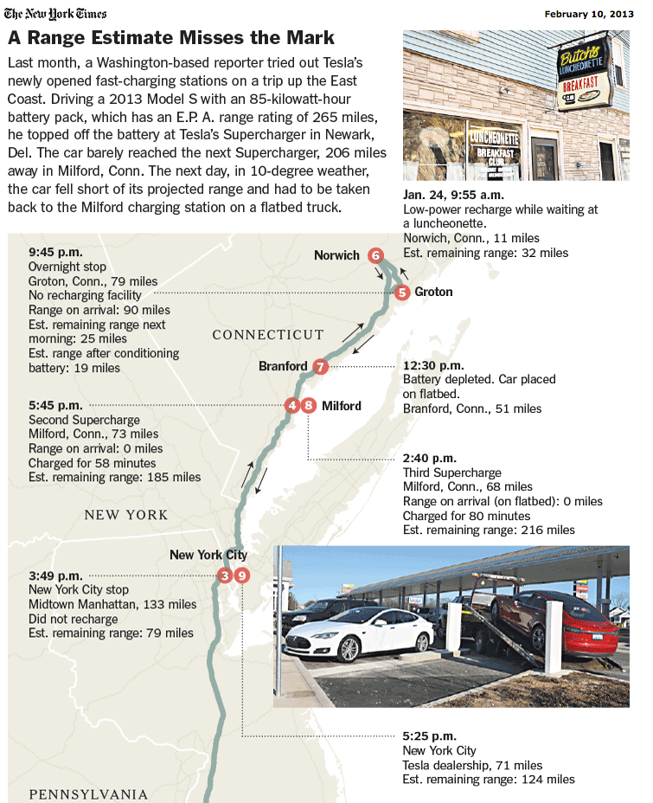
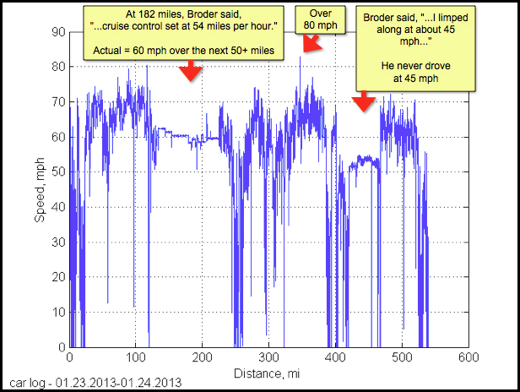
Vis Rhetoric
Notes:
An example of telling different versions of a story with data. Original NYT story, the tesla data, and on the next slide the why axis redesign

Slide 22
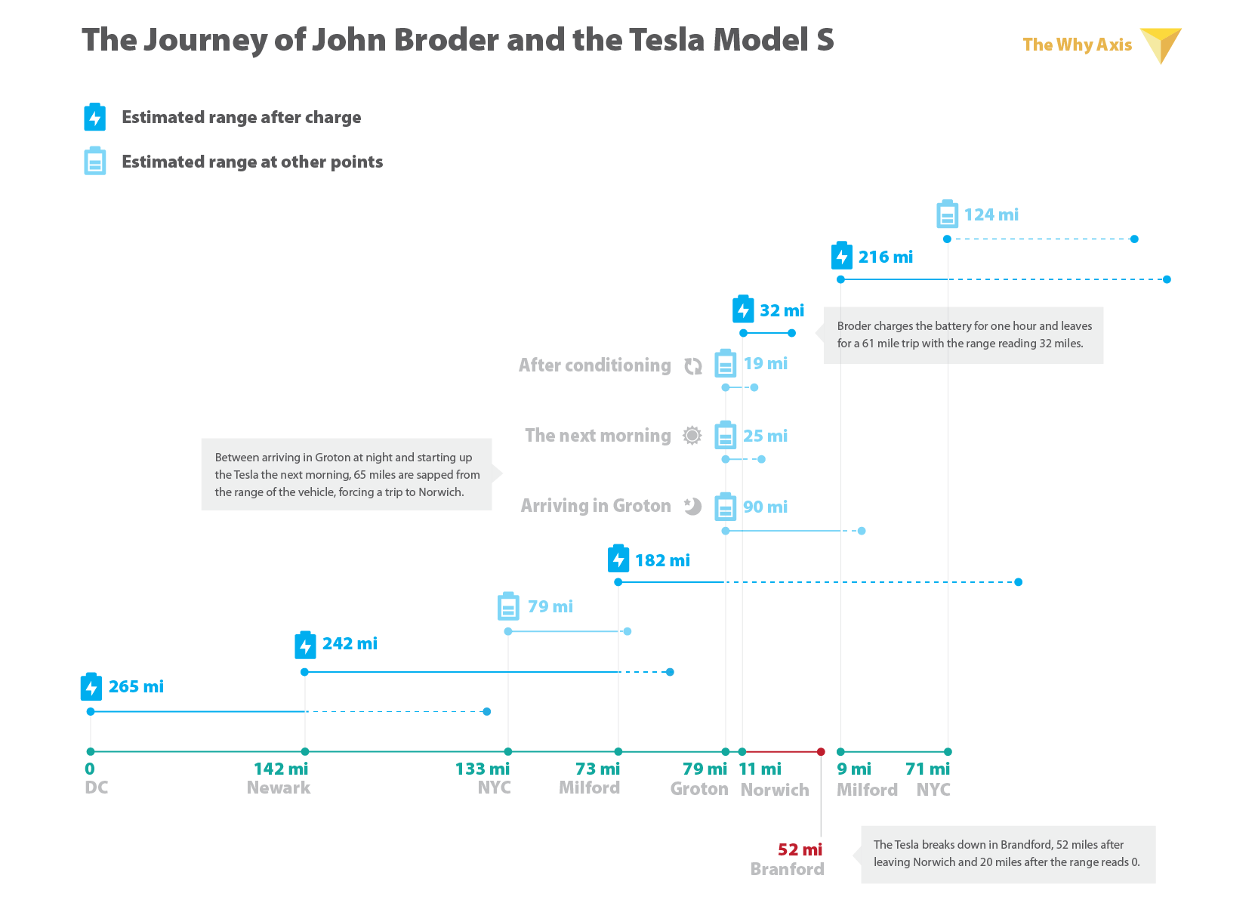
Redesign for Clarity
http://thewhyaxis.info/tesla/

Slide 23
Rhetorical Layers
Data
Includes / excluded variables, outlier removal, aggregation, normalization, ambiguous data definition
Visual Representation
Choice of mapping – can be more efficient, or more lossy
Spatial ordering primacy of reading convention
Annotation
As way of focusing and directing attention as well as framing interpretation, provenance info, uncertainty representation
Interactivity
Navigation capabilities, search / filter / goal suggestions, defaults and default views
Notes:
Can be achieved at different stages of the visualization.

Slide 24
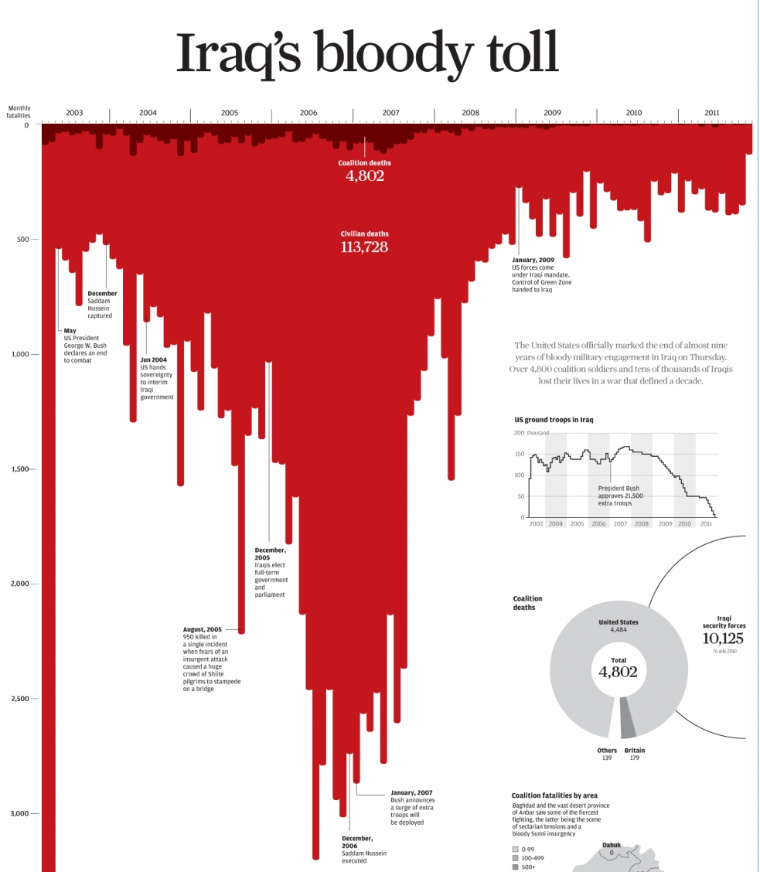
Vis Rhetoric: Connotation
http://www.scmp.com/infographics/article/1284683/iraqs-bloody-toll
Notes:
http://www.scmp.com/infographics/article/1284683/iraqs-bloody-toll
Downward pointing bars looks like blood running down the page.
Other suggestive spatial mappings: left = past, right = future;

Slide 25
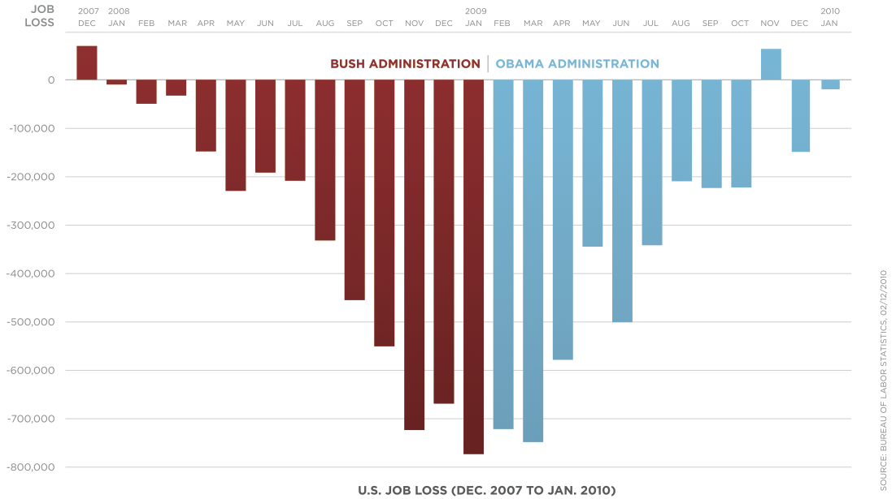
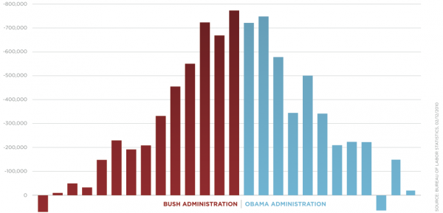
Vis Rhetoric: Orientation
https://eagereyes.org/blog/2012/bikini-chart
Notes:
The downward mapping of bars makes it so it looks like things are going down (getting worse) under bush, but going up (getting better) under obama. This leverages a learned association we have about down and up.
Another tweak here is the fade to darker red at the bottom of the red. This gives it the effect of drying blood.
Also mention this is a good example of a vis criticism from Kosara.

Slide 26
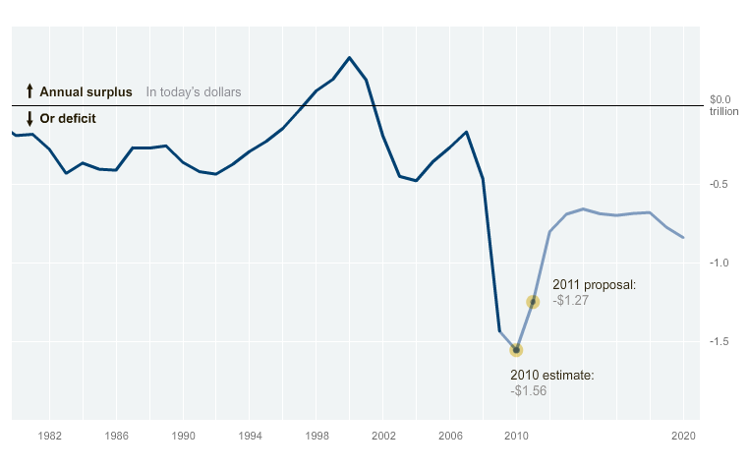
Vis Rhetoric: Animation
http://www.nytimes.com/interactive/2010/02/02/us/politics/20100201-budget-porcupine-graphic.html
Notes:
Animation used to “land” on a view that priviledges that view.

Slide 27
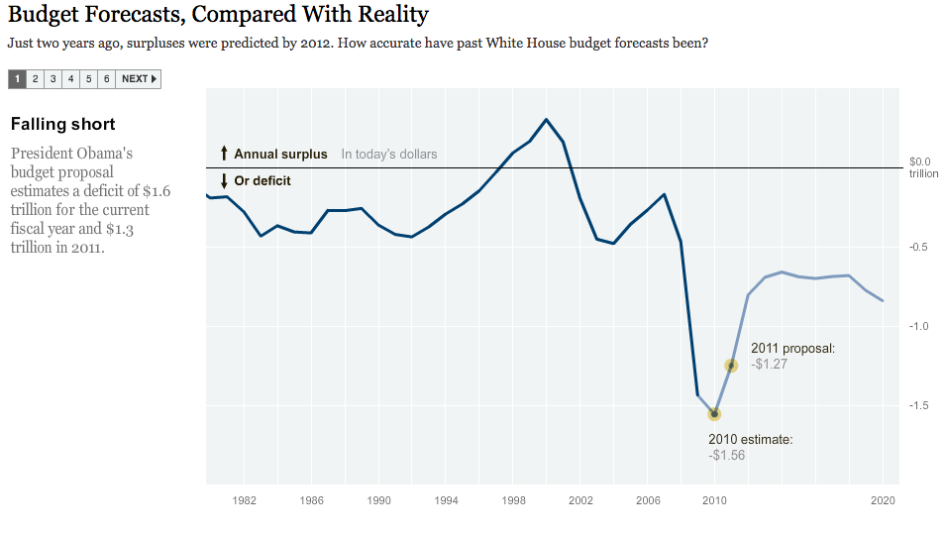
Vis Rhetoric: Rhetorical questions
http://www.nytimes.com/interactive/2010/02/02/us/politics/20100201-budget-porcupine-graphic.html
Notes:
Animation used to “land” on a view that priviledges that view.

Slide 28
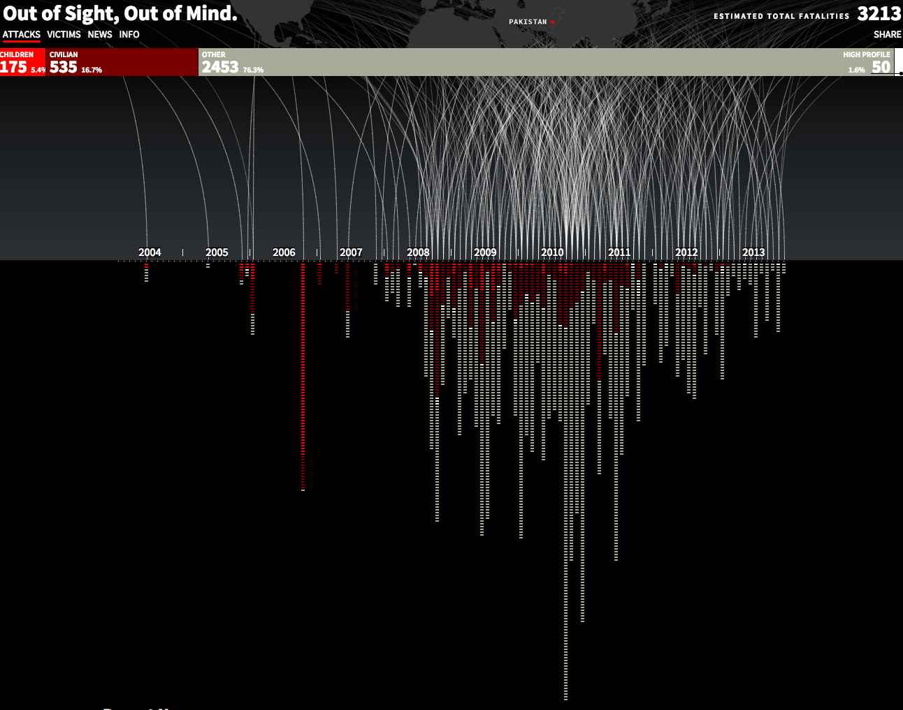
Vis Rhetoric: Metaphor
http://drones.pitchinteractive.com/
Notes:
Metaphor for a drone strike and explosion. Visually mimicking the the thing that you’re actually depicting.

Slide 29
Critique
"Critique is a form of analysis that uses critical thinking to determine whether a design is expected to achieve its desired objectives (and adhere to any pertinent best practices or heuristics)"
Conor and Irizarry in “Discussing Design”
Critique is one of 3 types of “feedback”

Slide 30
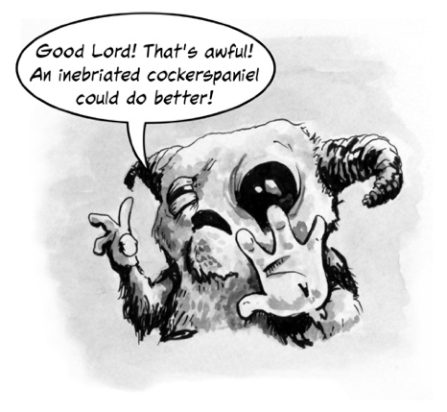
Reactive Feedback
Source: Discussing Design: Improving Communication and Collaboration through Critique.
Notes:
Driven by personal expectations, desires, values, opinions. Basically, a gut reaction. Unless you really just want to know what someone’s visceral reaction is it may not be that helpful.

Slide 31
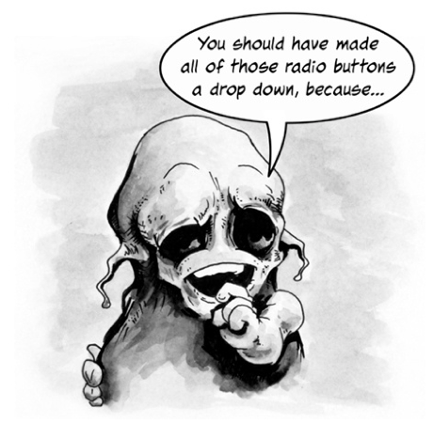
Directive Feedback
Source: Discussing Design: Improving Communication and Collaboration through Critique.
Notes:
Sometime ppl give feedback on what their own vision is for the design; but without rationale it misses the point that they might not have the same goals as the original design.
Doesn’t show how your design is effective or not in meeting objectives.

Slide 32
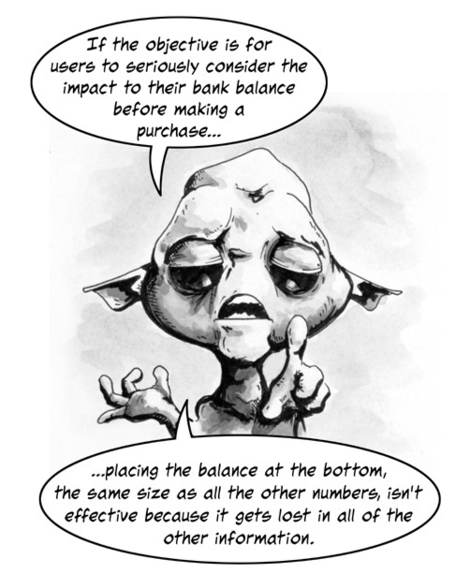
Critique
Source: Discussing Design: Improving Communication and Collaboration through Critique.

Slide 33
A Framework for Critique
What is the objective of the design?
What elements of the design are related to the objective?
Are those elements effective in achieving the objective?
Why or why not?
Source: Discussing Design: Improving Communication and Collaboration through Critique.

Slide 34
To Reiterate
Assess success, failure, possibility
Can you suggest a constructive way to improve something to reach a given design goal?
Should be based on evidence, design principles; not about taste or preference
Discuss the work, don’t attack the creator; Must explain WHY ideally in terms of best practices, heuristics and other guidelines
Starts from an understanding of the design goal / intent of the work
If you have access to designer: ask questions
Notes:
It’s really just about critical thinking applied to vis. Is there deception involved? What kinds of rhetorical techniques are being applied?
You need to know goal b/c otherwise you don’t really know which way is up

Slide 35
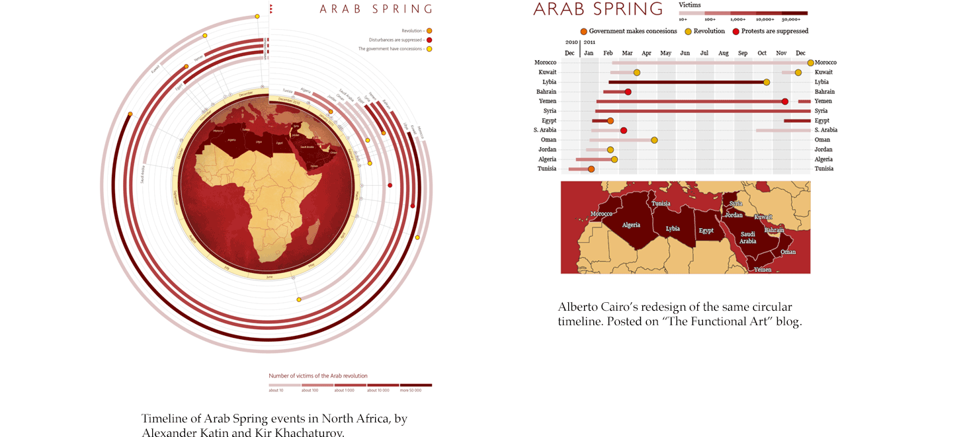
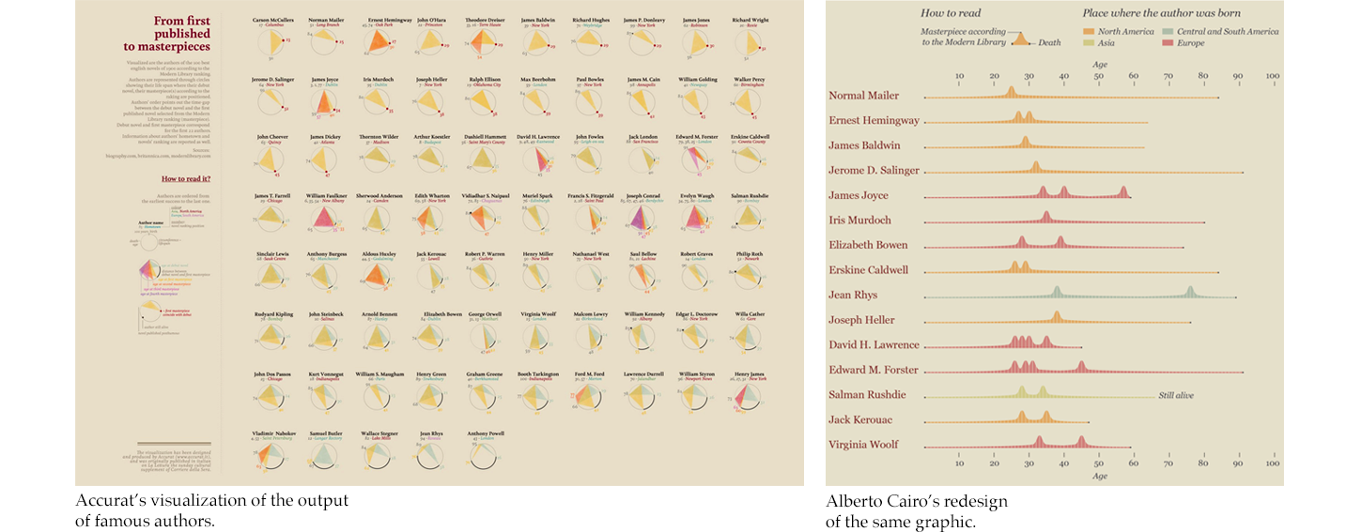
Critique by Redesign
https://medium.com/@hint_fm/design-and-redesign-4ab77206cf9#.e3ikpzeq1
Notes:
Can be useful to express alternative encodings.
BUT: keep in mind you may not be aware of the intent or goal of the original. Perhaps there were hidden constraints you don’t know about.
Take the 2nd example in moving from a radial mapping to linear. There was a lot of controversy on twitter. Though the linear mapping may have been more accurate, the radial mapping was seen as more aesthetic. You have to be aware that such critique happens in public.

Slide 36
Critique by Redesign
What are some of the drawbacks of critique by redesign?
You know the “answer” already
You know which variables matter and how to focus attention
You might not know the intent or constraints of the original
Public critique can result in context collapse
What are best practices for critique by redesign?
Be explicit about goal
Be honest about simplifying assumptions
Be sure to note positive aspects too
https://medium.com/@hint_fm/design-and-redesign-4ab77206cf9#.e3ikpzeq1

Slide 37
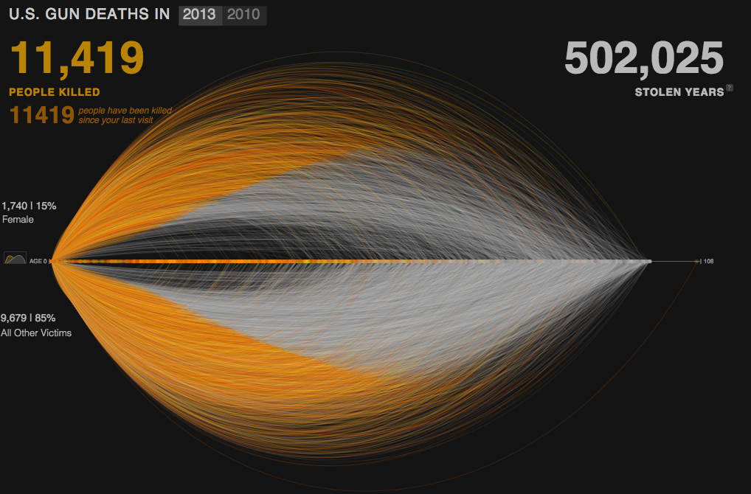
An Example
http://guns.periscopic.com/?year=2013
Notes:
http://guns.periscopic.com/?year=2013

Slide 38
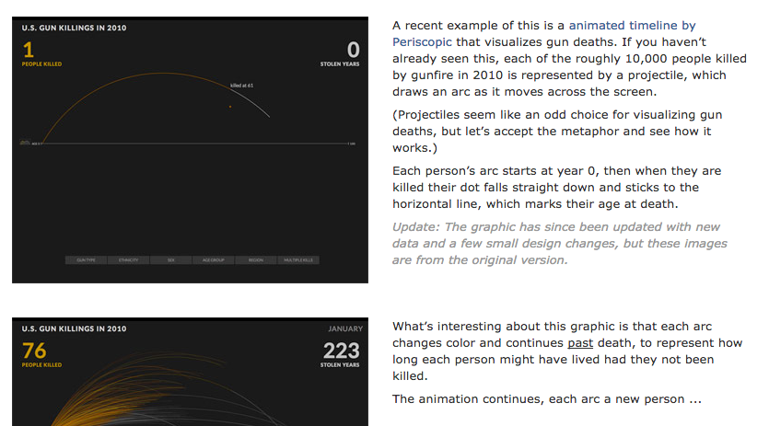
An Example Critique
Jonathan Corum. http://style.org/deleted/

Slide 39


Slide 40
Critique Activity
Find a Vis
Everyone get in a group of 3 and find a visualization for critique from Reddit: https://www.reddit.com/r/dataisugly/
What’s design goal / intent / objective
What is success for this visualization?
Assess success / failure w.r.t. objective
What are elements of design related to objective
Are they effective in achieving objective?
Can you suggest a constructive way to improve something?
(Or, reverse critique, suggest ways to make it worse!)
Why or Why Not?
Should be based on evidence, design principles; not about taste or preference
Notes:
You need to know goal b/c otherwise you don’t really know which way is up
Groups of 3; 20 minutes doing critique – create a slide show doc and post to wiki; each team has 3-4 minutes to explain their critique.

Slide 41
Questions?

